Slide 1


Work Instruction
Recommending Approval of
Disbursement Vouchers
Document Code: ZCMC-WI-FIN-02
Revision No.: 1
Date Effective: February 15, 2023

Slide 2
General Information
Work Instruction: Recommending Approval of Disbursement Vouchers
General Information
A. Objectives
To set the guidelines for Incoming and Outgoing of Disbursement Vouchers for payment.
B. Terms/Definitions/Acronyms:
DV- Disbursement Voucher
C. Scope
The procedure starts with the receipt of the Disbursement Voucher with the attached documents and ends up with forwarding the Disbursement Vouchers to the Office of the Medical Center Chief.
Page 2

Slide 3

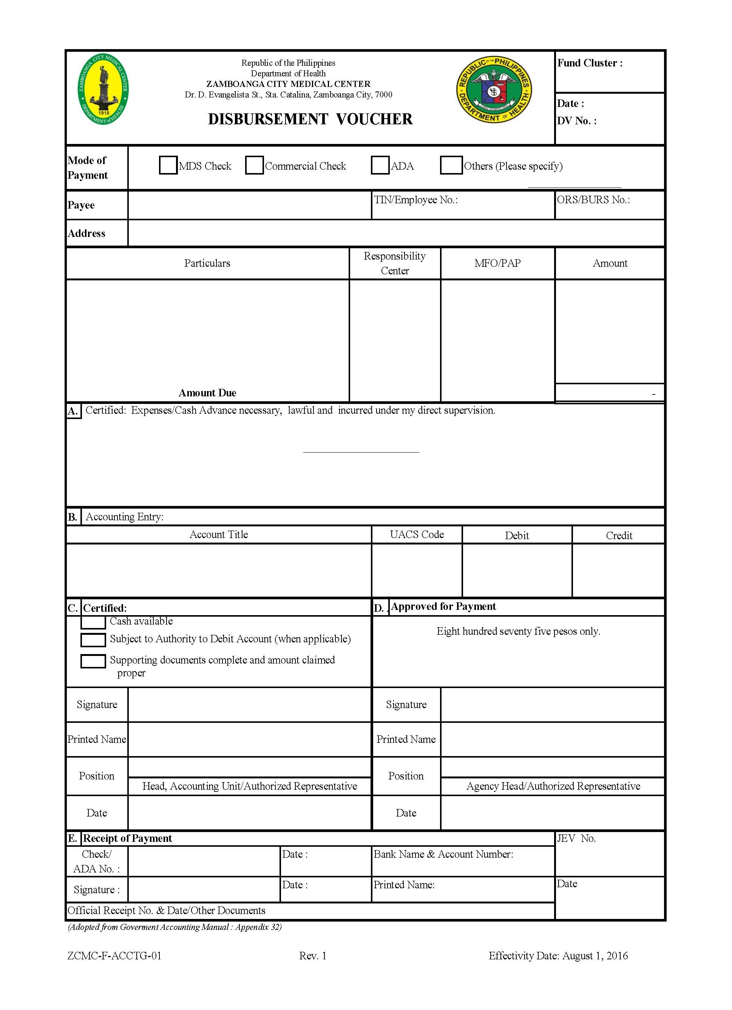
D. Instructions
Work Instruction: Recommending Approval of Disbursement Vouchers
Responsibility and Authorities
Administrative Staff / Records Management Staff
The Administrative Staff / Records Management Staff shall receive Disbursement Voucher from Accounting Section.
Check if the Disbursement Voucher is duly signed by Accountant, otherwise, return for appropriate action.
Log in the Disbursement Voucher details in the Disbursement Voucher Logbook.
Endorse the DV to the Financial & Management Officer II to recommend approval of payment.
Forward the signed document to the Office of the Medical Center Chief.
Page 3

Slide 4
E. Reference Documented Information
Work Instruction: Recommending Approval of Disbursement Vouchers
1. Government Accounting Manual for National Government Agency
2. DOH Department Order No. 2015-0260- Authorized Signatories for Certain Transactions in the Department of Health
3. Processing of Disbursement Vouchers (ZCMC-PR-FIN-01)
Page 4

Slide 5
F. Preparation, Review & Approval
Work Instruction: Recommending Approval of Disbursement Vouchers
Preparation, Review & Approval
Author/s
MODESTO M. VINLUAN III HAZEL C. TORIBIO
Reviewed By:
RICHARD FERDINAND B. BUCOY, MPA Financial and Management Officer II
Approved By:
SHADRINA T. SARAPUDDIN, MD, MPH, FPCP PGQMS Chair
Page 5

